Slide 1
Automated Classification of Craigslist Listings Using NLP
By: Stacy Chiok, Abigail Freidin, Andrea Riquezes Gete, Gage Mowry, Kayla Williams, & Devon Yee​

Slide 2
Project Overview
Goal: Classify Craigslist listing titles for "new" and "bulk" conditions and detect retailer mentions
Reduce computing costs in place of LLMs
Data- 100 manually labelled rows from NY dataset

Slide 3
Classifying New and Bulk Listings
Model: SBERT (Sentence Transformer Python Library)
Labels:
New: "Unopened, unused, new, sealed, or in original packaging" (Threshold: 0.3)
Bulk: "Plural items or large quantities of the same item" (Threshold: 0.12)
Detects New and Bulk item sentiment from title of listings
Returns binary score in dataset if listings are new or bulk

Slide 4
Retailer Detection
Retailer List: ~160 major stores from LPRC website
Method: Fuzzy matching with thefuzz (token_set_ratio, threshold = 70)
Preprocessing: Normalize text (lowercase, remove special characters)
Output: Matched retailer name or None

Slide 5
Classification Results
Number of items in test set: 100
Number of items manually labeled as bulk: 23
Number of items manually labeled as new: 8
Number of bulk false positives: 6
Number of bulk false negatives: 8
Number of new false positives: 6
Number of new false negatives: 4
Number of rows where both classifications were wrong: 1
Number of rows where both classifications were correct: 77
11% of rows had only one factor that model did not identify
0 rows had more than one factor where the model did not identify at least one of them

Slide 6
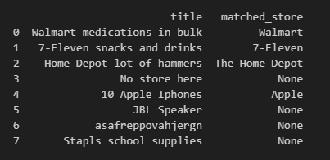
Retailer Detection Results
Used “fake” data due to lack of retailers in original dataset
Seemed perfect on small sample, again have no larger set to test on
Missed “Stapls”, or “Staples” due to misspelling
If spelling is correct, it seems quite good

Slide 7
Pros and Cons
Pros
Cons
Classification can likely be improved, had 50% accuracy on new rows and 65% accuracy on bulk for true positives (got 90% and 86% on the whole dataset)
Early Analysis on Retailer Name matching seems really promising
Cheap and easy
Probably not as accurate as leading LLMs
Some listings slip through the cracks
Less dynamic score than LLMs
Unable to determine “Low Price”
Total Classification Accuracy of 78%

Slide 8
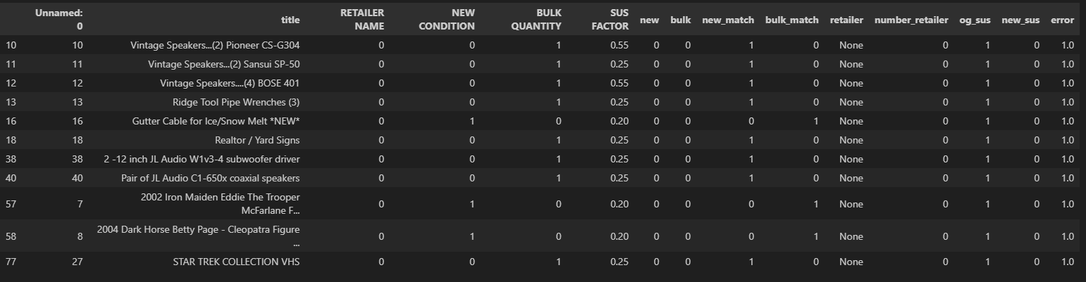
All False Negatives

Slide 9
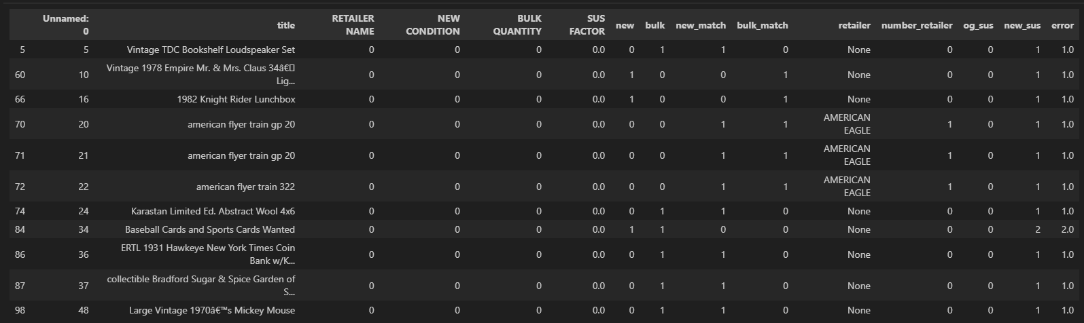
All False Positives

